Slide 1



Data Transformation DW 2.0 Design Document
Payers
Aug 2025 | www.citiustech.com
1

Slide 2
Current Landscape – High-level Schematic
Data Sources
Data Ingestion
(ETL Tools)
Data Warehouse (ODS / OneTSH)
Data Consumption
Business Capabilities
QNXT Orange (Medicare Advantage Claims)
QNXT Blue (Medicaid & Commercial claims)
Pharmacy (Abarca, CVS, Magellan)
SAP (ERP)
Avizzor(Part B Claims)
MedCompass (Clinical Data)
Abartys, Resultados (ADT & Lab Data)
Medispan( Master Drug Db)
Salesforce (Marketing Data)
Avaya, Five9, TurnosPR (Call Center)
Stepwise (Rating & Quoting)
ONBASE,Wipro-M360 (Member Data)
ONBASE,Wipro-M360 (Member Data)
CMS
DWS, Cost Plus Billing, Wipro (Billing)
Assertus(837 In), RightFax( Prior Auth), Interwell(ESRD)
Other Sources (Refer : Data Source Master)
Claims Mgmt.
OneTSH
B2B
Pharmacy Benefits Mgmt.
Power BI
Actuarial
Sales & Underwriting
Informatica Workflows
SSIS / SSRS
Clinical (Care & Case Management)
Portals
Product
ODS
SSIS Scripts
Adhoc / PowerQuery Excel
Customer Enrolment (Membership)
Python / R
HEDIS Quality
Scheduling and Orchestration (CTRL-M)
Finance
MS Office (PPT, SharePoint, Excel)
Provider Network Mgmt.
OneTSH Sandbox
Data Sidra
Business Applications
Operations
Service
Analytics
Triple-S’ current data ecosystem lacks a unified platform, requires disparate systems for data validation.
Data availability and accessibility challenges. Data quality causing overhead in generating actionable insights.
Data trust issues due to lack of validations, ex: sales team transforms data manually.

Slide 3
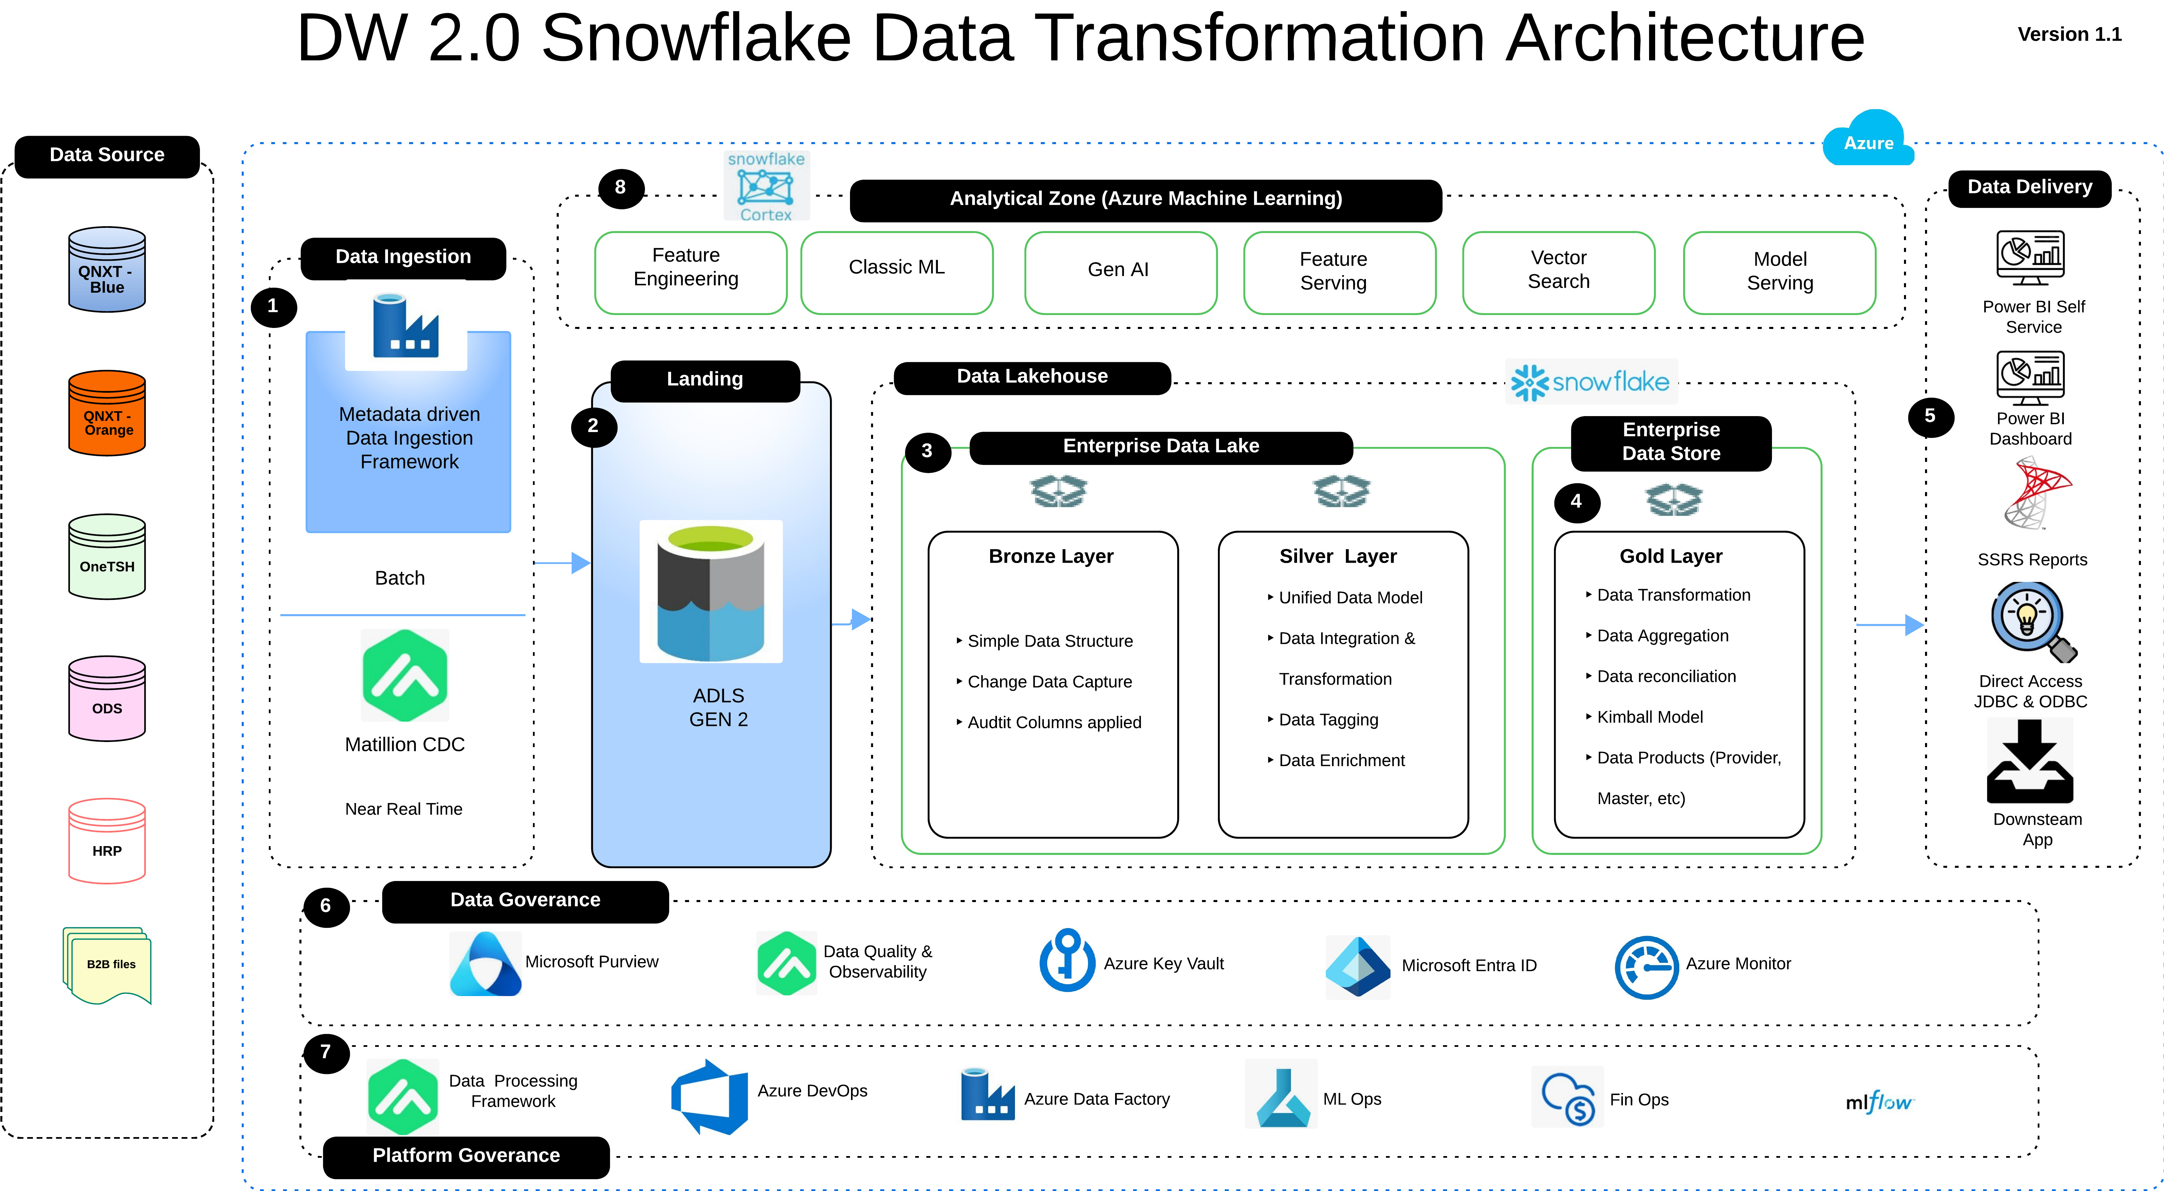
DW 2.0 Data Transformation Architecture
Notes:
Triple-S : Azure US East 2 region

Slide 4
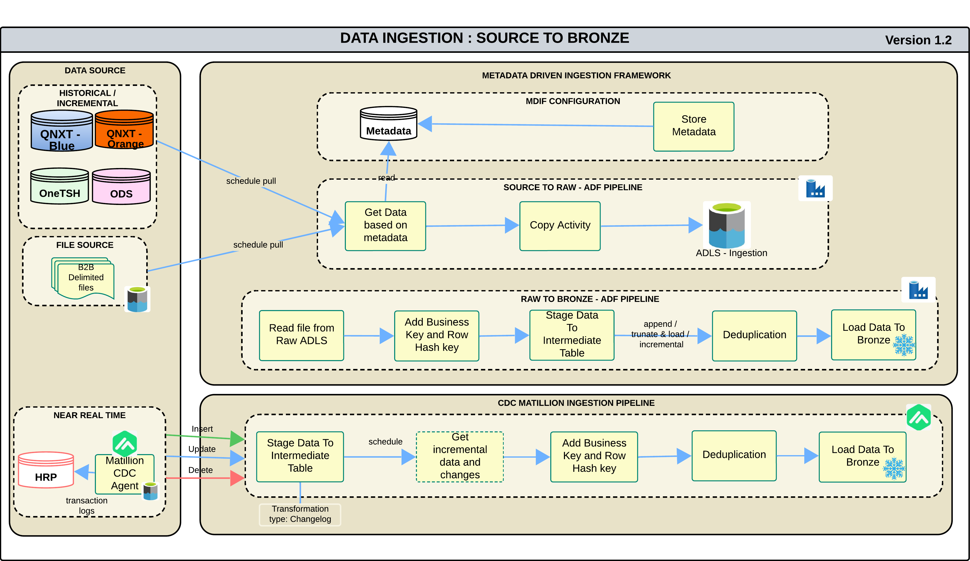
Design - Data Ingestion to Bronze Layer
Historical data is ingested from multiple source systems—including QNxt, OneTSH, and the ODS SQL Server database—spanning various Lines of Business (LOBs).
The Metadata Ingestion Framework (MDIF) accelerator, built on Azure Data Factory (ADF), orchestrates the scheduled loading of historical data into the DW 2.0 environment.
Business-to-Business (B2B) delimited files going into OneTsH are also integrated into the MDIF ingestion pipeline.
Health Rules Payer (HRP) data, replicated from Oracle to SQL Server, is ingested in real time using Matillion’s Change Data Capture (CDC) Agent with an incremental scheduled pull mechanism.
The current ("As-Is") data load from source systems to the Snowflake Bronze layer is implemented through the data ingestion pipeline.
During ingestion into the Snowflake Bronze layer, a deduplication check is performed to ensure data integrity and eliminate redundancies. Only deduplicated data is loaded into the Bronze layer to maintain consistency and quality across the pipeline.
MDIF continues to process historical data alongside incremental HRP data loads, using a source system segregation approach to manage and streamline ingestion.
Notes:
Artefacts link :
MDIF : Metadata Driven Ingestion Framework for Triple-S.pptx
Design Exceptions:
Handling of similar claims from both historical and incremental HRP
Out of scope:
API data ingestion
EDI data ingestion
Outboard data extract

Slide 5
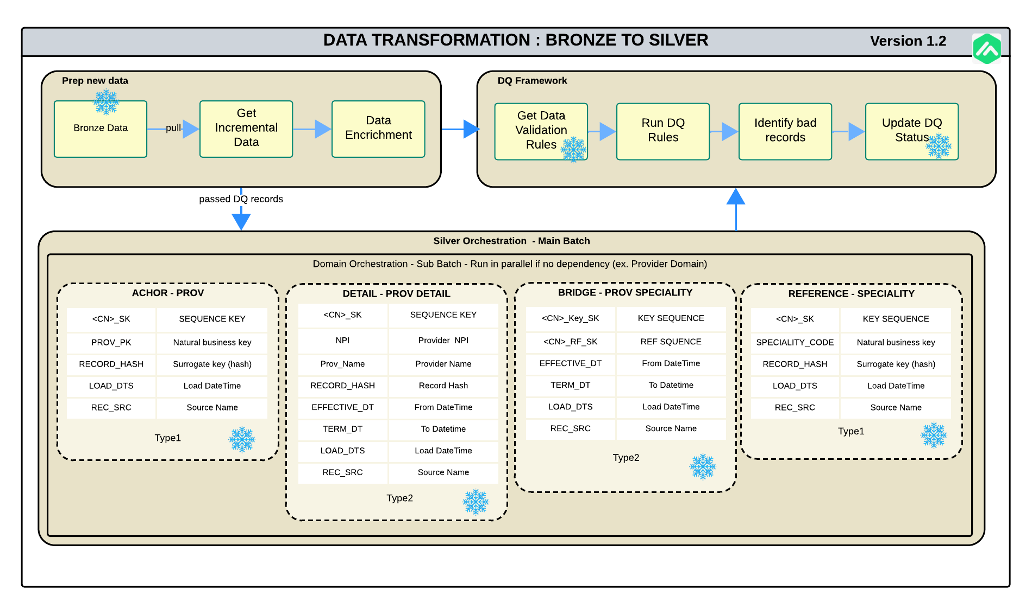
Design – Data Transformation Bronze to Silver Layer
Bronze data for historical and incremental is integrated into unified silver layer data platform after applying the business transformation and enrichments.
Data Quality (DQ) rules specific to each domain are applied during transformation, with validation outcomes logged for audit and monitoring.
A standardized hybrid data vault data model is implemented using anchor, detail, bridge, link, and reference tables to ensure consistency, scalability, and traceability.
Matillion is used to perform lightweight cleansing and transformation tasks, guided by metadata-driven configuration tables stored in Snowflake.
Generic Matillion pipelines are designed to read configuration metadata and implement pushdown execution logic to Snowflake for populating Silver layer tables.
Parallel execution of domain-specific sub-batches is enabled where dependencies are absent, improving performance and throughput.
Metadata framework enables dynamic orchestration and reusability across domains, minimizing manual intervention.
Matillion ETL_Framework.ptx ,
Medallion Architecture Overview.pptx
Notes:
Artefacts link :
Matillion ETL framework
DQ Framework
Design Exceptions:

Slide 6
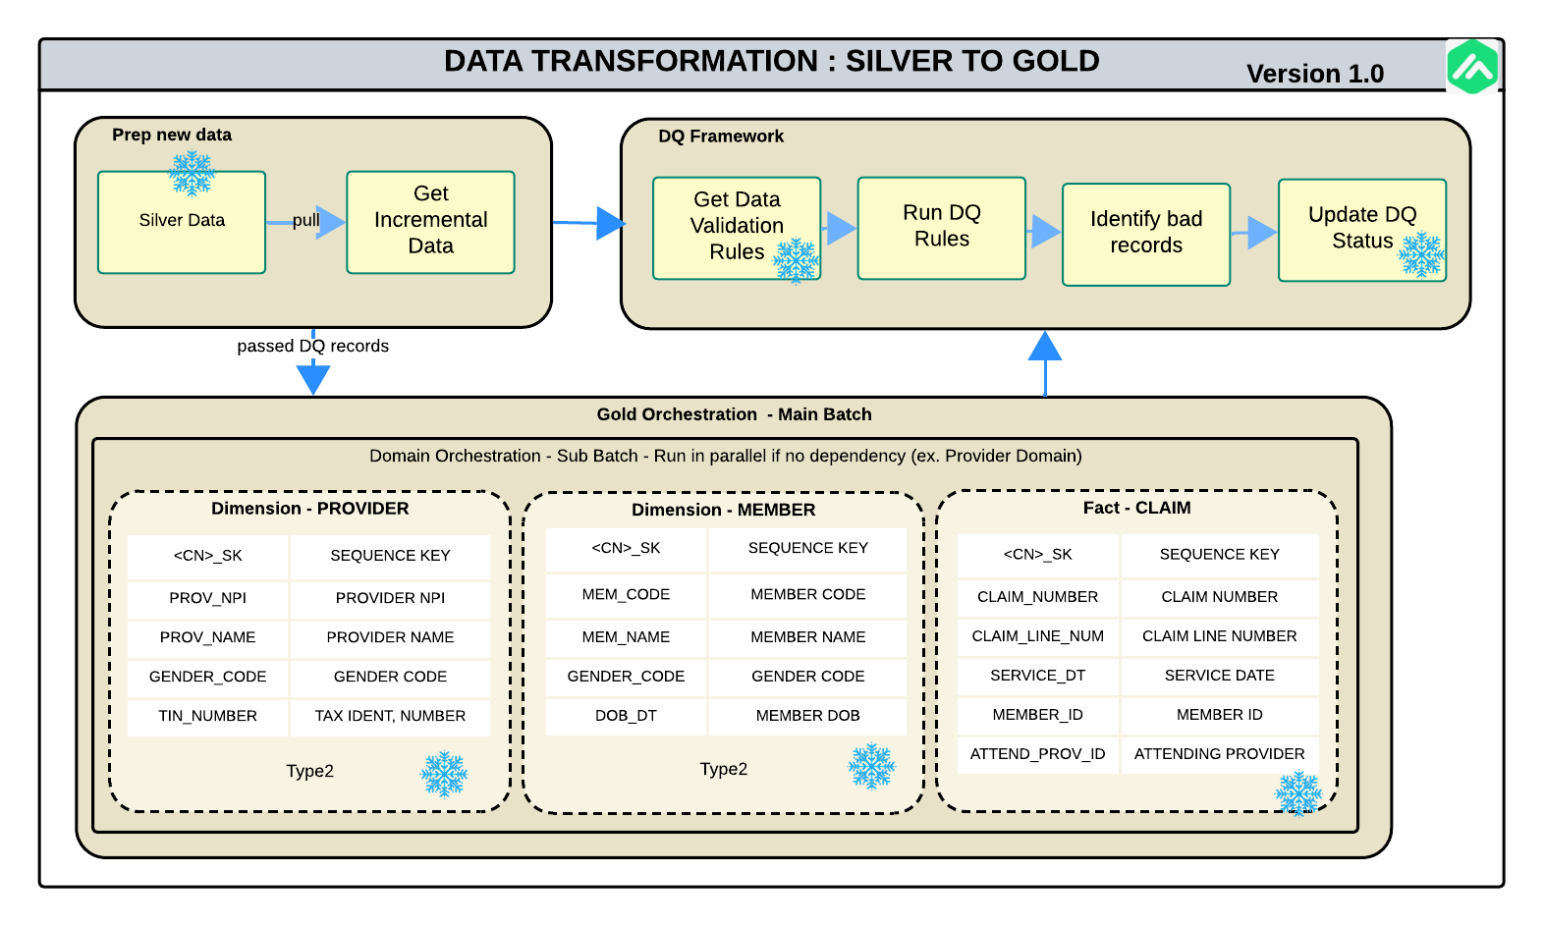
Design – Data Transformation Silver to Gold Layer
Business rules and aggregations are applied using Matillion during Silver to Gold transformation.
Gold layer uses denormalized dimensional models for reporting and analytics.
Hybrid approach enables lift-and-shift of existing reports and development of new models on Snowflake.
Data marts are created to support existing dashboards and reporting needs.
Existing reports are rewired to consume data from the new Snowflake platform.
Semantic layer is built in Snowflake and Power BI for self-service analytics.
Member 360, Provider 360, and Clinical 360 data products are enabled via denormalized views.
Metadata enrichment and lineage tracking are implemented for governance and traceability.
Notes:
Artefacts link :
Matillion ETL framework
DQ Framework
Design Exceptions:

Slide 7
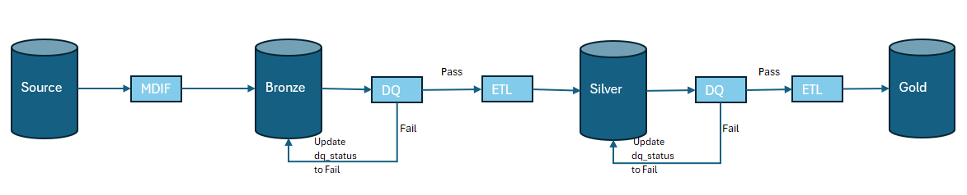
Design – Data Quality
Metadata driven data quality framework implemented as part of Matillion pipelines.
Data Quality checks performed on silver and gold later data using rule-based configuration for Accuracy, Completeness, Consistency, Uniqueness, Timeliness, and Validity.
DQ rules stored in Snowflake metadata tables, Matillion orchestration dynamically reads and applies DQ rules on data feed.
Sample Data Quality Rules
Rule ID | Data Layer | Entity | Is Critical? | Attribute | Rule Description | Rule Category | Subcategory
PRV-1 | Silver | Provider | Yes | Provider ID | The 'Provider ID' field cannot be blank. Each 'Provider' requires a respective 'Identifier (ID)'. | Uniqueness | Mandatory Data Check
PRV-2 | Silver | Provider | No | First Name | Each 'Provider' requires the 'First Name' field in upper case | Accuracy | Mandatory Data Check
PRV-3 | Silver | Provider | No | Last Name | Each 'Provider' requires the 'Last Name' field in upper case | Accuracy | Mandatory Data Check
PRV-4 | Silver | Provider | No | Address | Each 'Provider' requires a "Address Line 1" | Accuracy | Missing Data Check
PRV-5 | Silver | Provider | No | City | The respective 'City' for this 'Provider' cannot be empty. | Accuracy | Missing Data Check
PRV-6 | Silver | Provider | Yes | State | The respective 'State' for this 'Provider' must contain either its name or abbreviation. | Validity | Missing Data Check
Matillion_Data_Quality_ETL_Framework.ptx

